Slide 1

Smart Tourism & Crowd Management Analytics
A Modern Big Data Pipeline for Egypt Touristic Hotspots
SIC 7
BD Course
G 20
Notes:
Note:

Slide 2

What do you think?!!
Notes:
Note:

Slide 3
Agenda
Team
Introduction
Problem Statement
Methodology
Key Tasks
Results and Insights
Conclusion
Q&A
Notes:
Note:

Slide 4
Team
Sherin Mohamed Kamal (Pipeline Engineer)
Esraa Ahmed Khalil (DataOps/Orchestration Lead)
Mariam El-Habashi (Data Architect)
Notes:
Note:

Slide 5
Agenda
Team
Introduction
Problem Statement
Methodology
Key Tasks
Results and Insights
Conclusion
Q&A
Notes:
Note:

Slide 6

Introduction
Why Tourism Analytics?
One of Egypt’s most important economic sectors
Historical sites receive thousands of daily visitors
Managing congestion is difficult without real-time data
No unified system for understanding patterns or predicting crowding
Project Goal: Build a complete Big Data pipeline to collect, store, and process tourism data for real-time and historical crowd insights.
Notes:
Note:

Slide 7
Agenda
Team
Introduction
Problem Statement
Key Tasks
Methodology
Results and Insights
Conclusion
Q&A
Notes:
Note:

Slide 8
Problem Statement
Challenges in touristic hotspots:
Unpredictable crowd spikes
Safety & capacity issues
Manual or outdated monitoring
No integration of weather or holiday effects
No automated ingestion or continuous real-time visibility
We need: A fully automated data pipeline → Source → Ingest → Store → Transform → Analyze
Notes:
Note:

Slide 9
Agenda
Team
Introduction
Problem Statement
Methodology
Key Tasks
Results and Insights
Conclusion
Q&A
Notes:
Note:

Slide 10
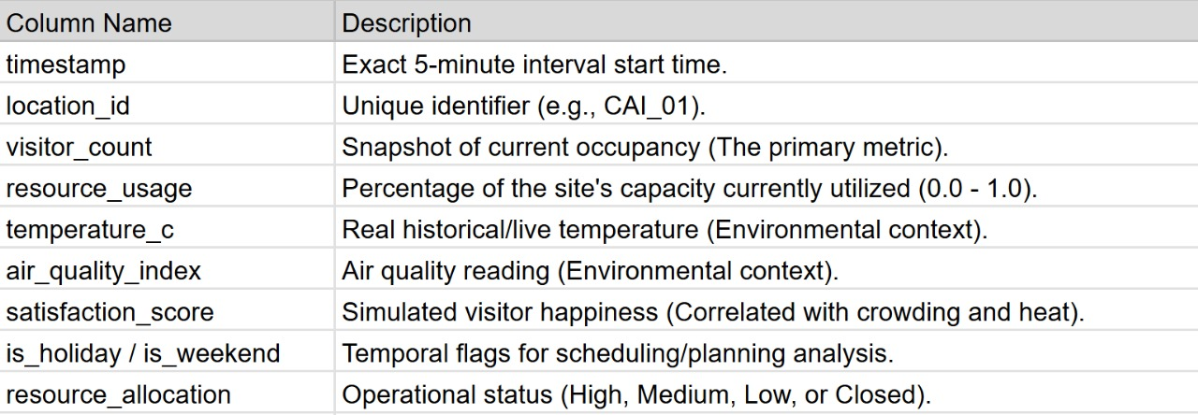
Data Description: Smart Tourism Analytics Dataset
Data Foundation (The Source)
Hybrid Volume: 23 Million Historical Records + Continuous Live Stream.
Granularity: 5-minute intervals for 60 major tourist sites.
Deployment: Data generated by Python Sensor running 24/7 on Azure VM.
Notes:
Note:

Slide 11
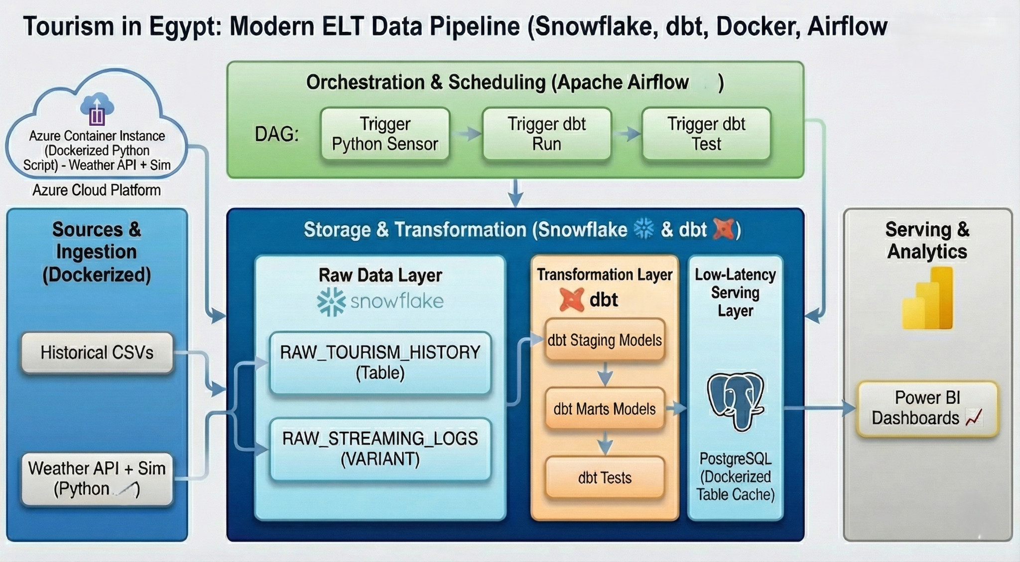
Project Pipeline
Notes:
Note:

Slide 12
Agenda
Team
Introduction
Problem Statement
Methodology
Key Tasks
Results and Insights
Conclusion
Q&A
Notes:
Note:

Slide 13
Key Tasks
Ingest data from batch history, streaming events, and external APIs
Store all raw data in Snowflake Raw Layer
Build transformations using dbt
Simulate IoT-like streaming using Python
Orchestrate workflow using Airflow DAGs
Build analytics-ready Marts for dashboards
Enable real crowd insights: peak hours, anomalies, weather impact
Notes:
Note:

Slide 14
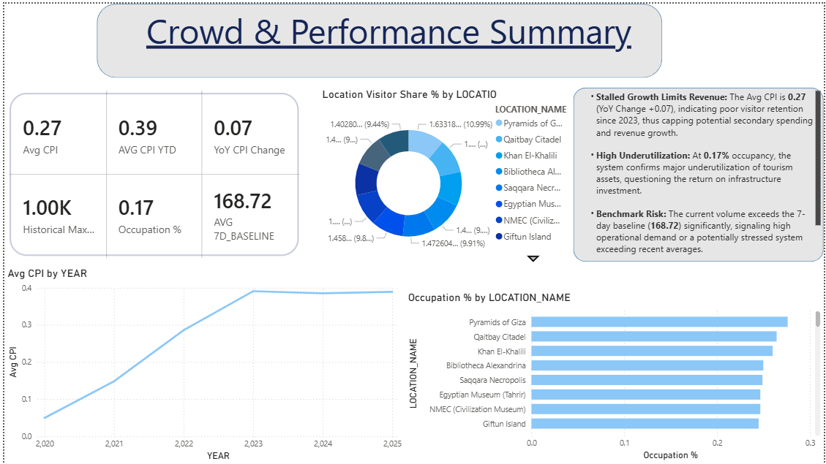
Results & Insights

Slide 15
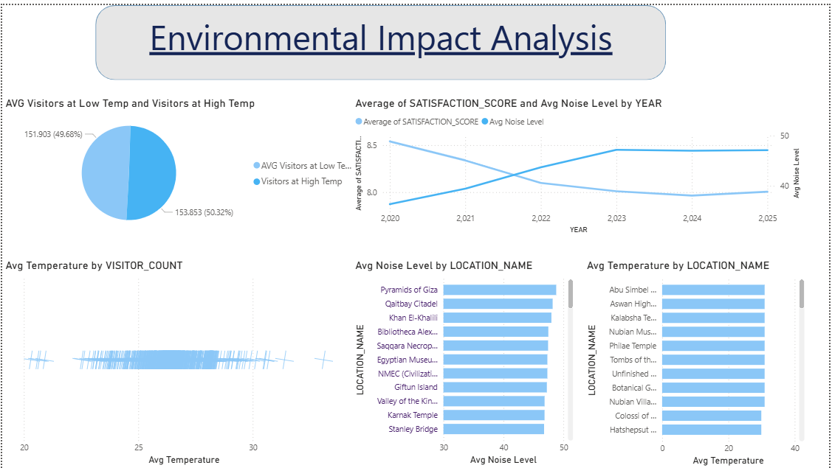
Results & Insights

Slide 16
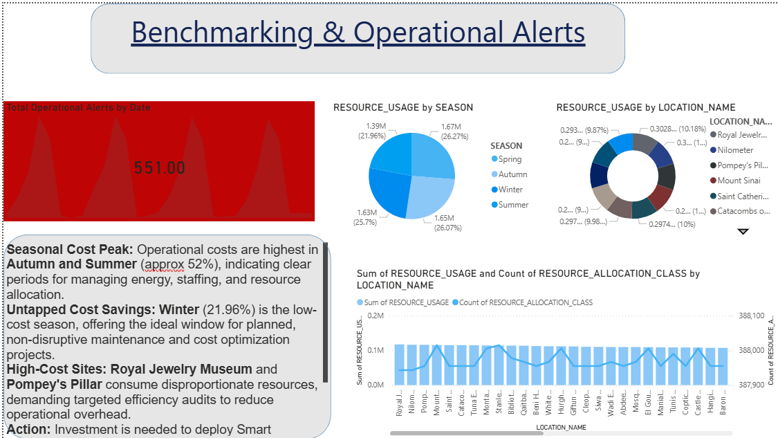
Results & Insights

Slide 17
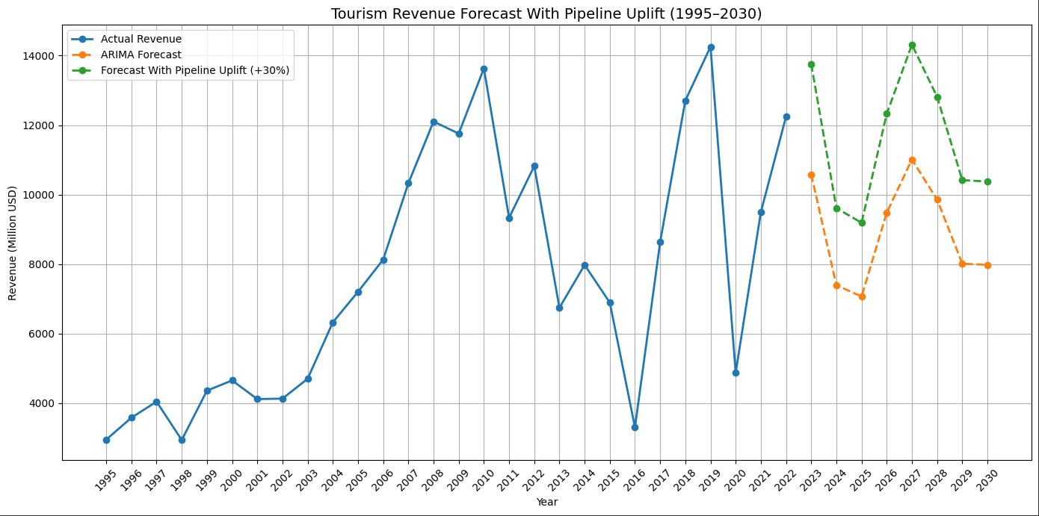
Economical Impact

Slide 18
Conclusion
dbt + Snowflake makes the ELT process more scalable, modular, and trusted.
Transformations become version-controlled and testable.
Data mart enables fast analytics and business reporting.
The approach is reusable across any data team.
Historic Egypt

